Slide 1
Application for the ASAP Final #12

Slide 2
How can I apply?
1
2
3
Fill out
Fill out the following application template (max. 10 slides). You can also use your own design.
Save
Save the file as PDF
(max. 10MB) and name it after your startup idea and the university you represent.
(e.g. ASAP_HdMStuttgart).
Apply
Go through the application process and upload the PDF there. This step only needs to be done once per start-up idea.
Deadline Mon, 01/07/2024, 10am

Slide 3
What are the scoring criteria?
Originality and Unique Selling Proposition
Why does the world need your idea? From self-employment to high-tech startup, we want to understand how you make the world a better place with your idea.
Quality of the
validation
How well did you validate your idea? Prove to us through data and facts that people think your idea is good and are interested in it.
Readiness
for the
next step
How motivated are you to actually implement your idea? Do you have the skills in the team or do you know what is missing?

Slide 4
What are your benefits?
Certificate & ECTS
You and all teammates receive a certificate of participation and have the opportunity to get 3 ECTS credited.
Pitch in the Final #12
If you are accepted, you can pitch your idea at the final #12 on July 16th and win great prizes. Check www.asapbw.gruendermotor.io/en/final/

Slide 5
Application Template!
Just for your application,it's NOT your pitch deck for the final!

Slide 6
„Name of your startup idea“
Insert the name of your startup idea as the title of this slide.
Describe your startup idea.
Optional: Feel free to add your logo here.

Slide 7
Team
Introduce yourself or yourselves: What skills do you bring to the table and what university/universities do you represent?
Optional: Include a photo of you.

Slide 8
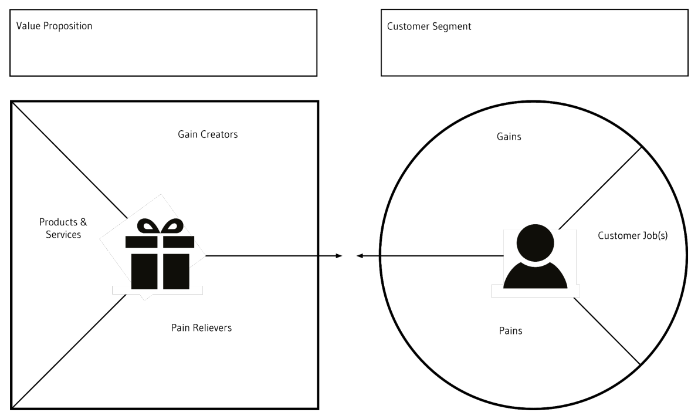
1. Problem Solution Fit
Value Proposition Canvas
Who are your customers? Which problem do you solve for them?
How did you validate it?
As an alternative to the Value Proposition Canvas on the right, you can also describe your User Personas.

Slide 9
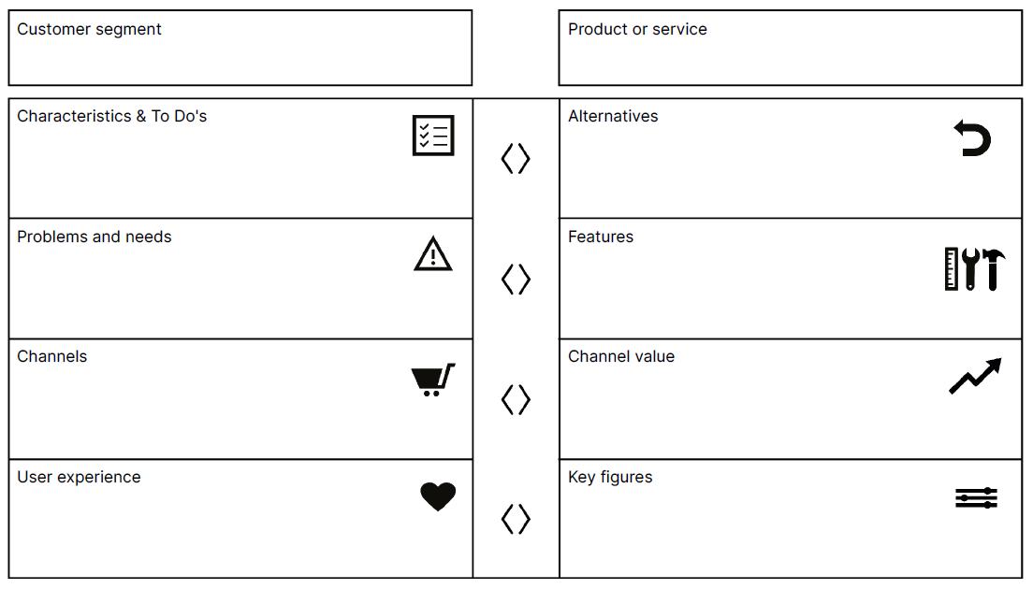
2. Product Market Fit
Product Market Fit Canvas
What does your product/service look like? How did you test your prototype? As an alternative to the Product-Market-Fit Canvas on the right, you can also insert photos or visualizations of your prototype and describe the core properties.

Slide 10
3. Market
Petal Diagramm
How big and attractive is the market you want to enter? Who are your competitors?
As an alternative to the petal diagram you can use the TAM-SAM-SOM or another visualization.

Slide 11
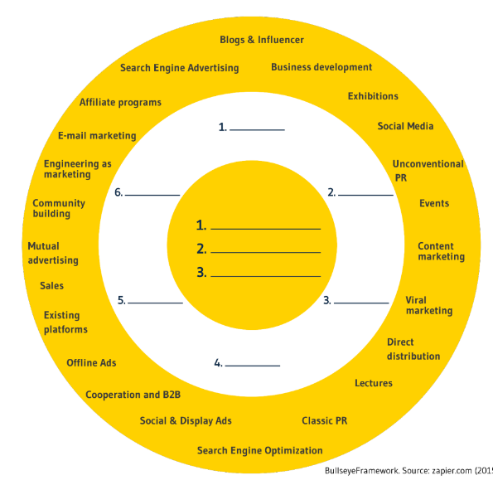
4. Traction
Bullseye Framework
How do you reach an actual customer demand? Which channels do you use and how do you measure their success?
As an alternative to the bullseye framework you can use the traction scoreboard or another visualization.

Slide 12
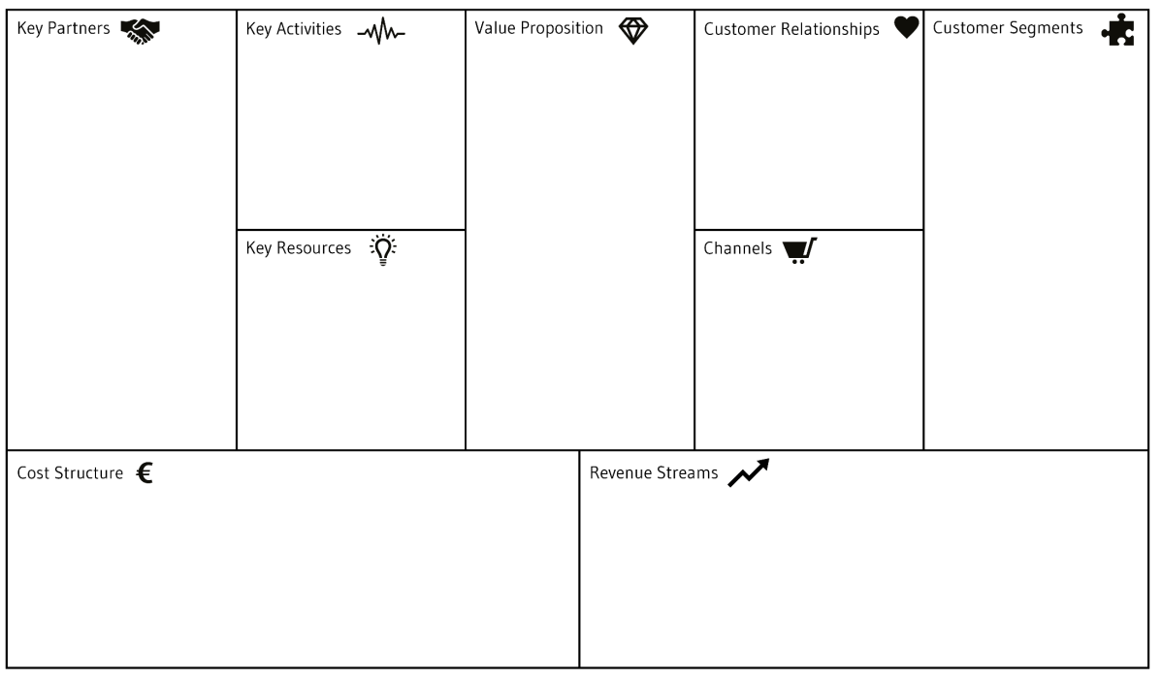
5. Business Model Fit

Slide 13
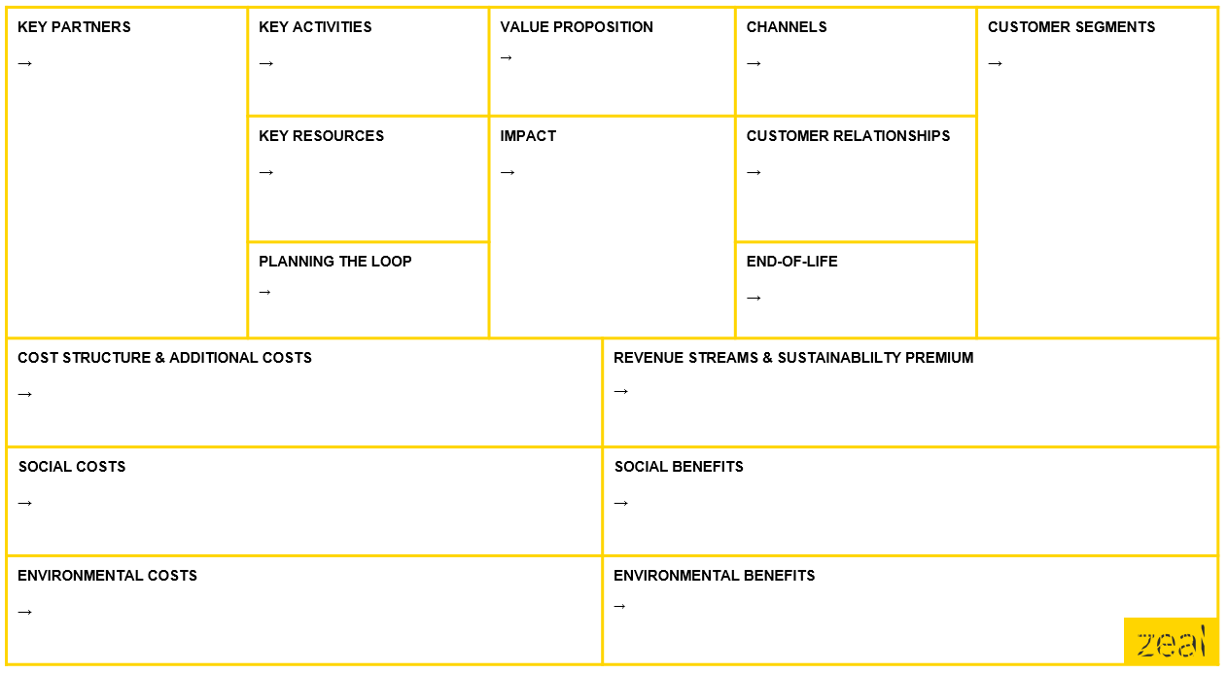
Optional: Sustainable Business Model Canvas

Slide 14
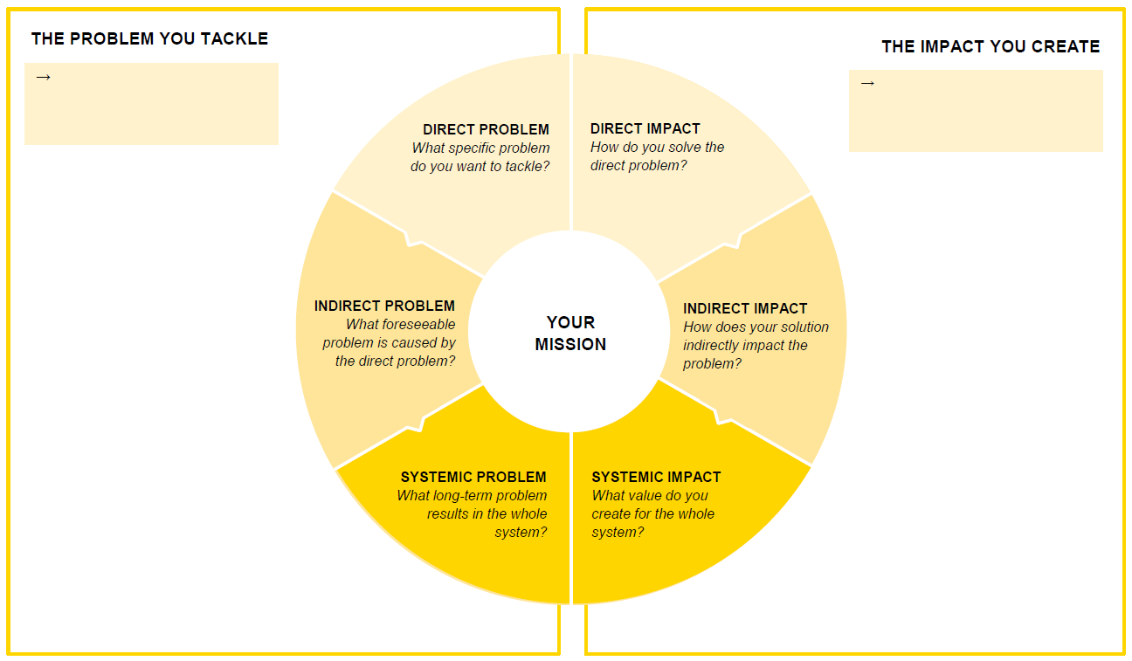
Optional: Impact Canvas

Slide 15
Appendix 1
Here you can optionally add more info, images or visualizations about your startup idea.

Slide 16
Appendix 2
Here you can optionally add more info, images or visualizations about your startup idea.

Slide 17
Appendix 3
Here you can optionally add more info, images or visualizations about your startup idea.

