Slide 1

Application
For the ASAP Finale

Slide 2



What is the application process?
Fill in the form
Fill out the following application template (max. 12 slides).
Feel free to use your own design.
Save it
Save the file as a PDF (max. 10 MB) and name it after your startup idea and the university you represent (e.g. CookieBot_HdMStuttgart).
Apply for the ASAP Finale
Upload your final PDF via the application process on the website.
This step only needs to be done once per startup idea.

Slide 3

Bewertungskriterien
Degree of innovation & relevance
Why does the world need your idea? What is new, different or better?
Validation & market feedback
How well have you tested or validated your idea?
Is there initial data, user feedback or other evidence that your target group is interested?
Ability to launch
How well prepared are you to pursue your idea?
Do you know your next steps and what skills you may still be missing?

Slide 4
Bewertungskriterien
Pitch quality
How convincingly do you present your idea? Do you get the key aspects in a nutshell?
Awards
The jury will present four awards - each with its own focus:
Innovation Award - for particularly novel ideas
Impact Award - for solutions with a major social impact
Business Model Award - for convincing business models
Best Pitch Award - for the best presentation
Ask yourself: Does your idea fit particularly well with one of these awards? Emphasize the strengths of your idea.

Slide 5



What is in it for you?
Certificate and ECTS
If you submit the following template, all team members will each receive a certificate and thus the opportunity to have 3 ECTS credited by your own examination office.
Traction and visibility
Pitch your idea on our big stage and gain visibility throughout Baden-Württemberg.
Prizes and further programs
Win prizes of up to 1000€ with your idea and get to know the contact persons for further programs.

Slide 6
These presentation slides only act as a framework to support your content. Please don't let the design limit you - we are primarily interested in understanding your idea and seeing that you have thought it through and validated it.
Please note: This deck is only for the application process. It’s not the one you'll use in the final pitch!

Slide 7


Application template

Slide 8
„Name of your Startup idea“
Describe your startup idea.
Optional: Feel free to add your logo and links to your website/social media channels here.

Slide 9
Team
Introduce yourselves: What skills do you have and which university or universities do you represent?
Optional: Add a photo of yourself.

Slide 10
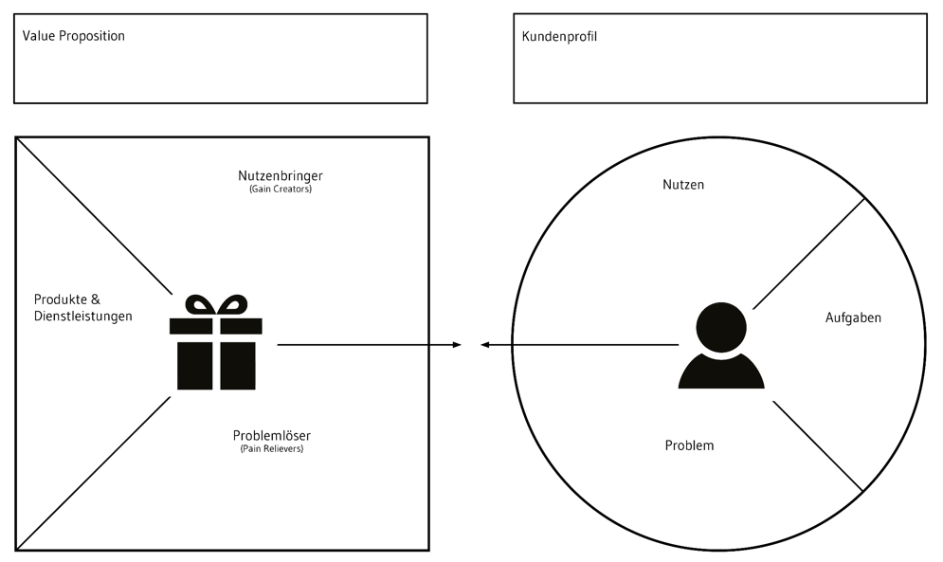
Challenge 1: Problem Solution Fit
Value Proposition Canvas
Who are your customers? What problem do you solve for them? How did you validate?
Alternatively, feel free to replace the value proposition canvas on the right with a user persona.
If you do, just enter your persona details in the same space.

Slide 11
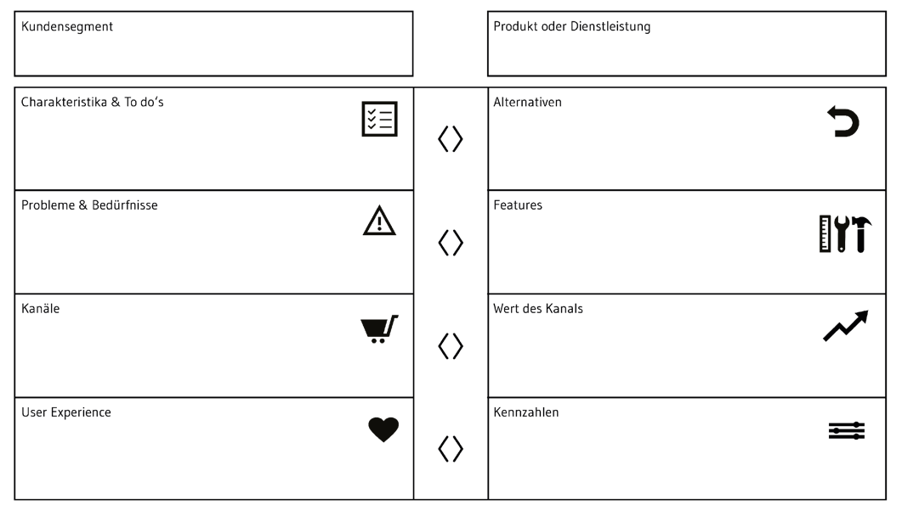
Challenge 2: Product Market Fit
Product Market Fit Canvas
What does your product/service look like?
How was the prototype tested?
As an alternative to the product-market-fit canvas on the right, you can also insert photos/visualizations of your prototype and describe the core features.

Slide 12

Challenge 3: Markt
Petal Diagramm
How large and attractive is the market you want to tap into? Who are your competitors?
Alternatively, you can also use TAM-SAM-SOM or another visualization.

Slide 13
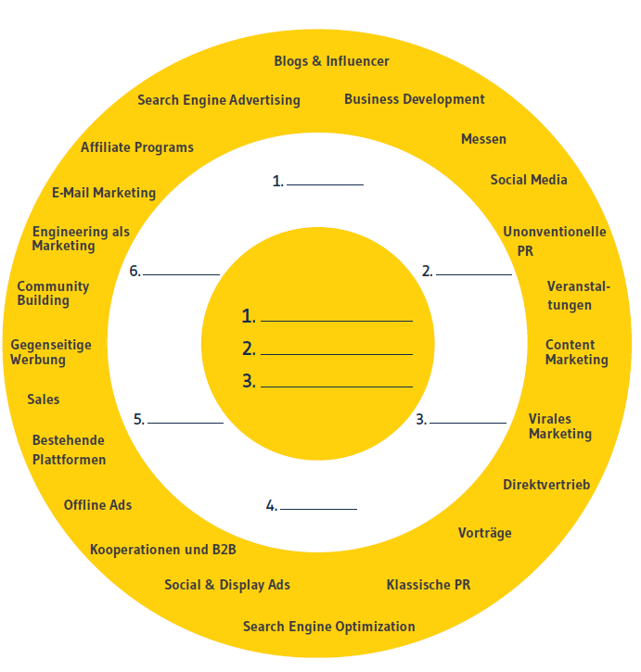
Challenge 4: Traction
Bullseye Framework
How do you achieve real customer demand?
Which channels do you use or want to use and how will you measure their success?
Alternatively, you can also use the Traction Scoreboard or another visualization.

Slide 14
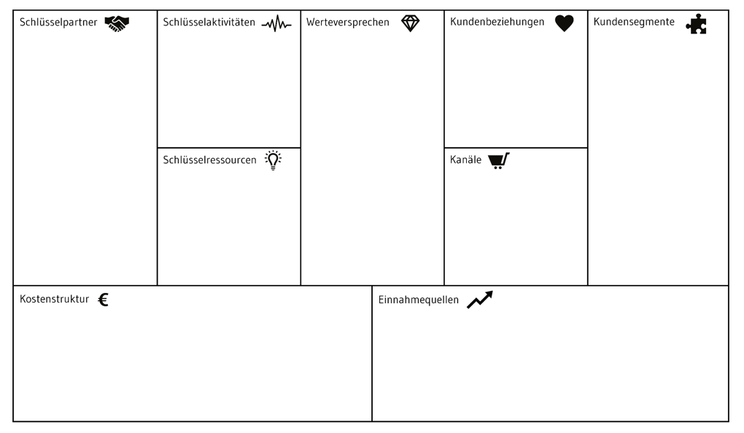
Challenge 5: Business Model Fit
As an alternative you can use the Sustainable Business Model Canvas on the next slide.

Slide 15
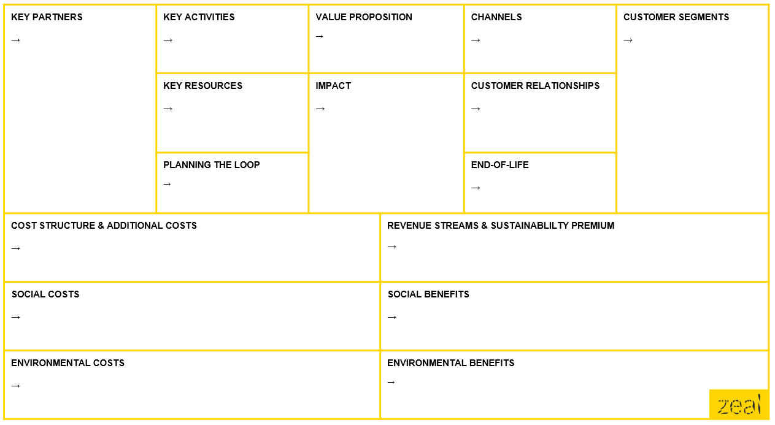
Alternative: Sustainable Business Model Canvas

Slide 16
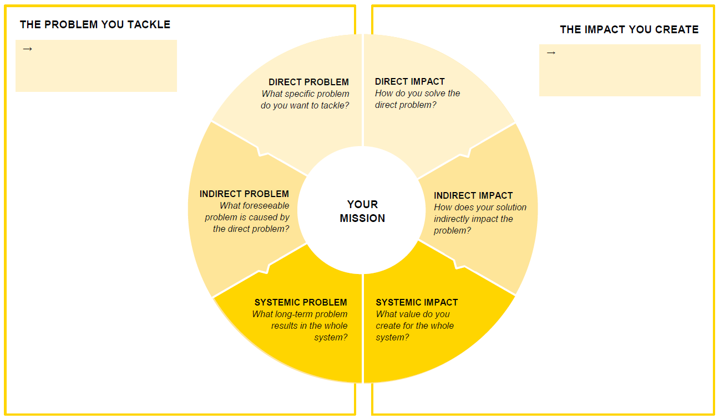
Optional: Impact Canvas

Slide 17
Appendix 1
Here you can optionally add further information, images or visualizations of your startup idea.

Slide 18
Appendix 2
Here you can optionally add further information, images or visualizations of your startup idea.

Slide 19
Appendix 3
Here you can optionally add further information, images or visualizations of your startup idea.

